Slide 1
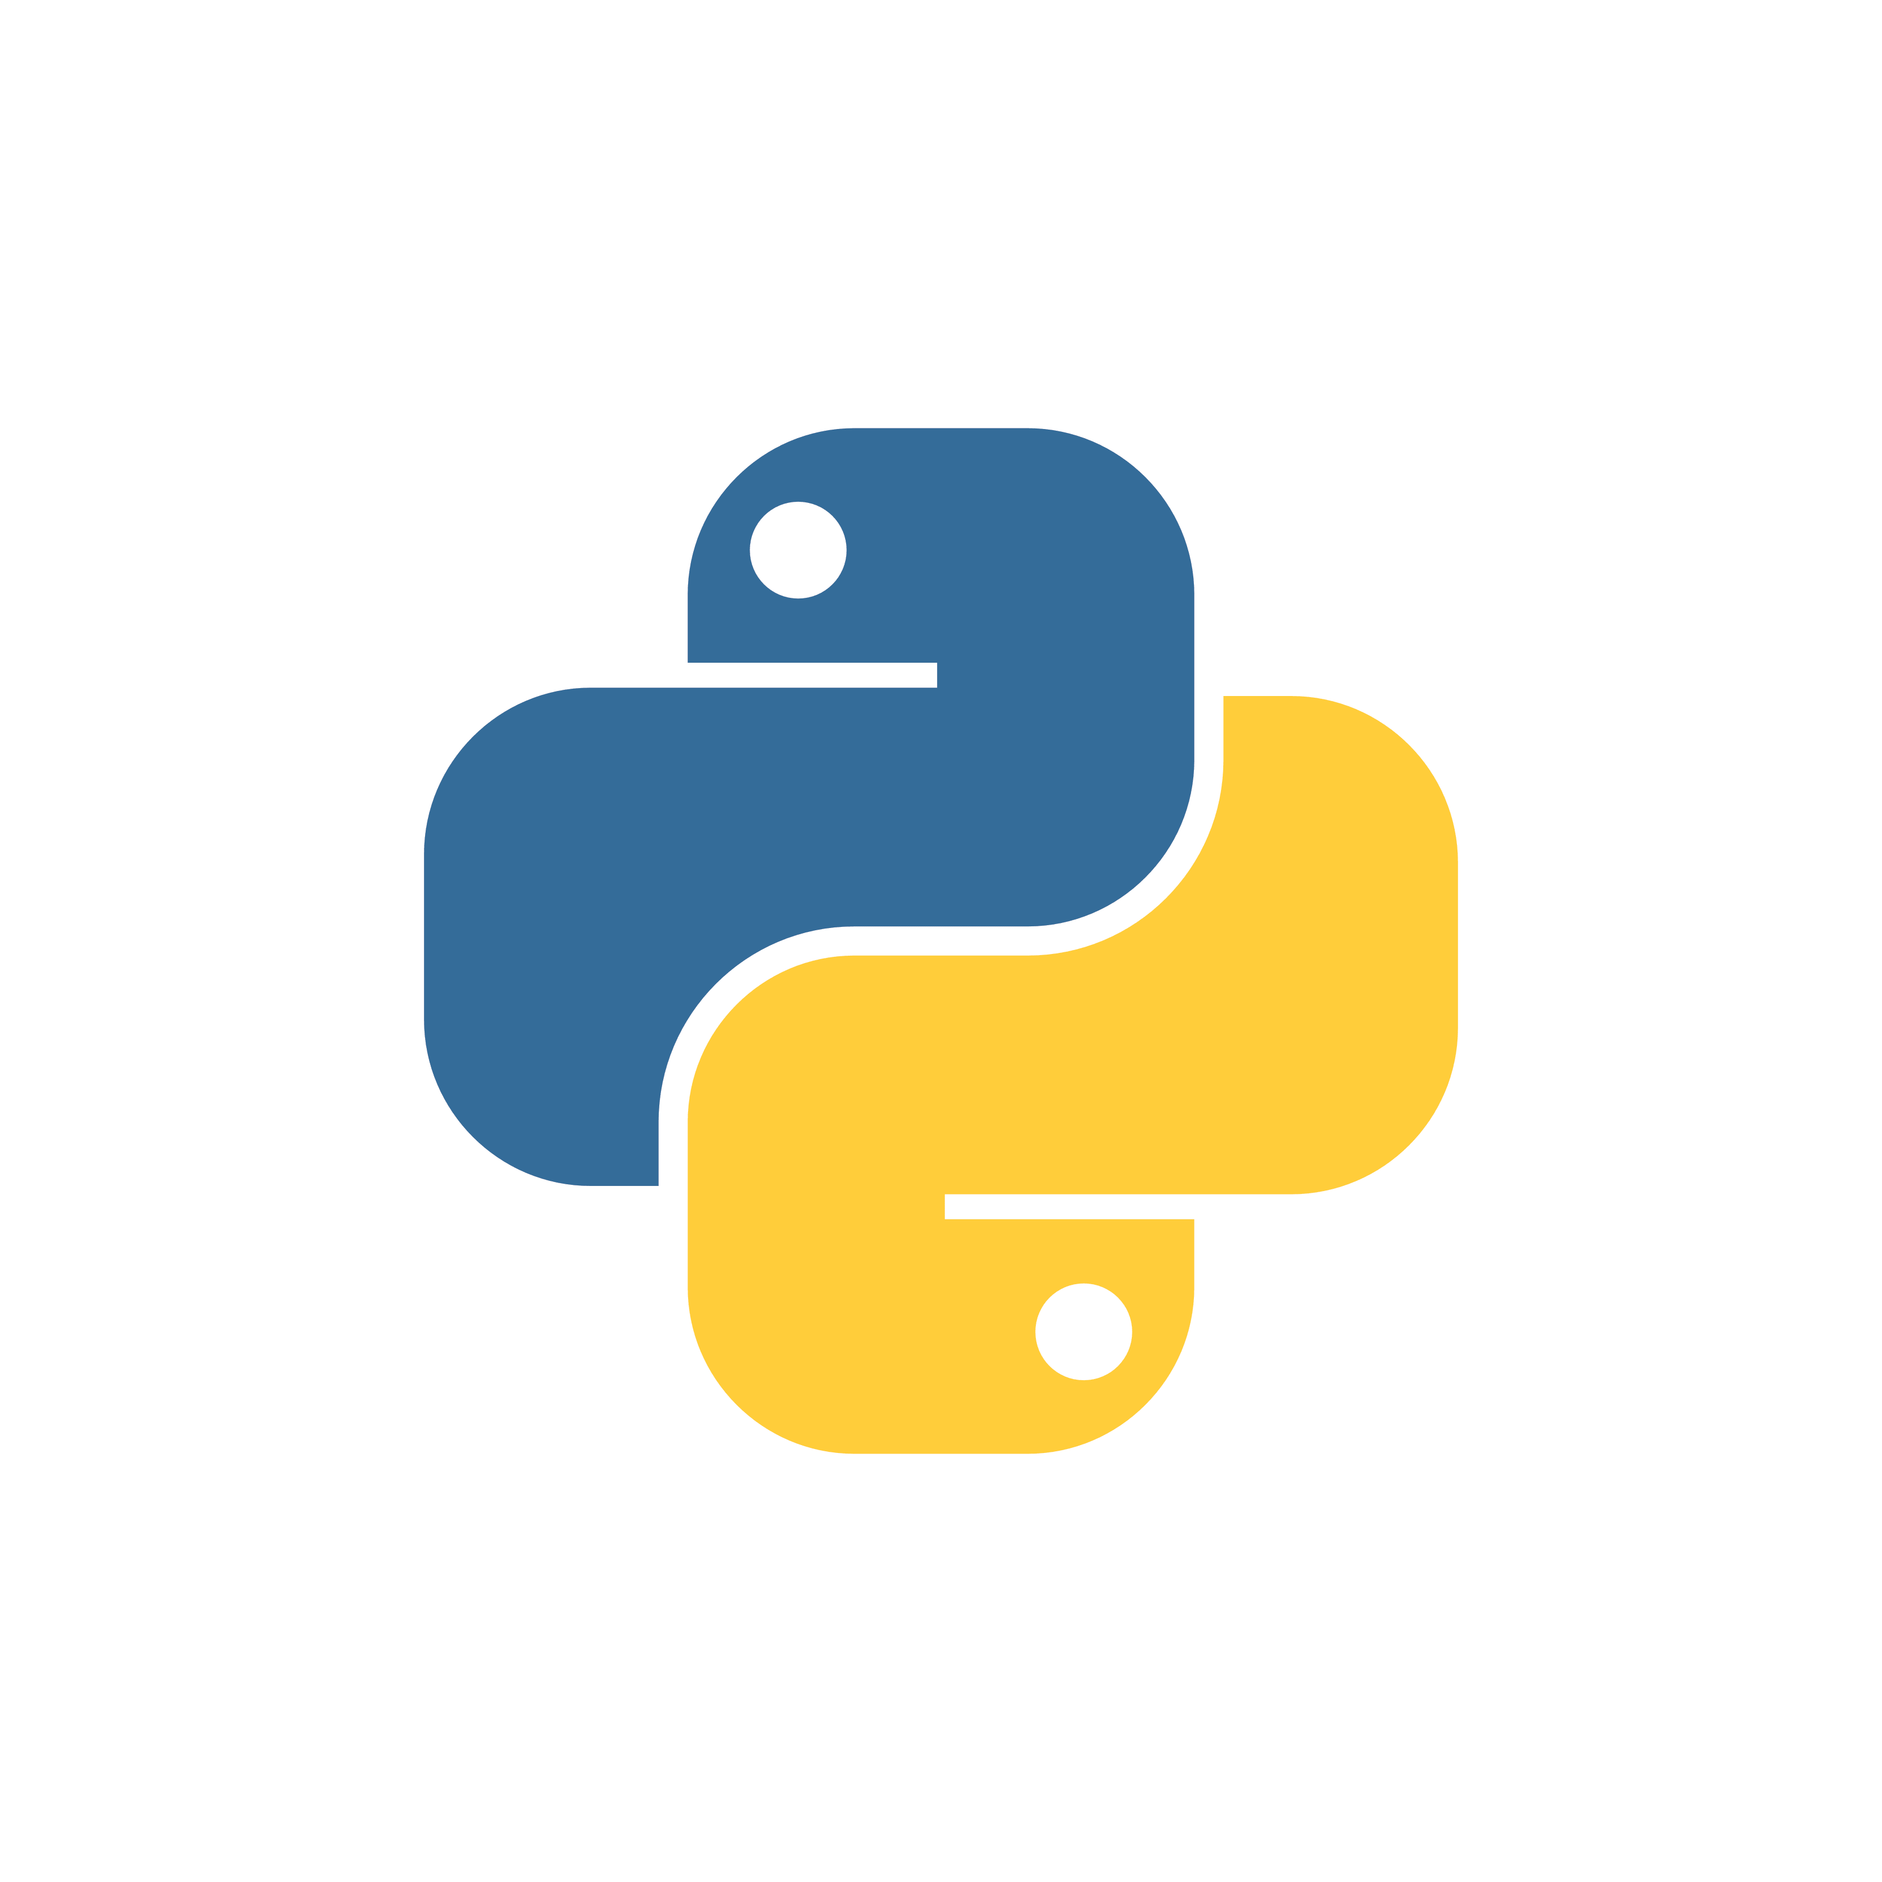
Introduction to Python
Eng. Fatma Gamal

Slide 2
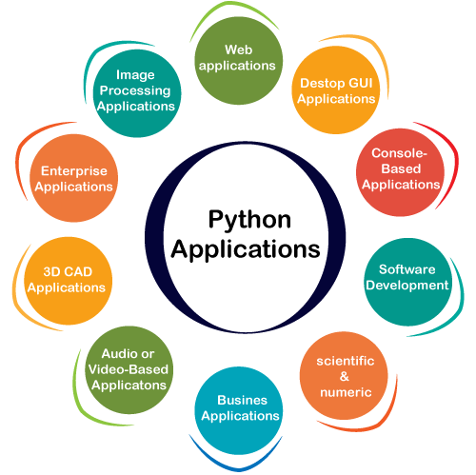
What is Python?
Python is a popular programming language. It was created by Guido van Rossum, released in 1991.

Slide 3
Python Features
Easy to Learn and Use
Expressive Language
Interpreted Language
Cross-platform Language
Free and Open Source
Object-Oriented Language
Extensible
Large Standard Library
GUI Programming Support
Integrated
Dynamic Memory Allocation

Slide 4

Python Installation
Anaconda distribution
The Anaconda distribution is a repackaging of Python aimed at developers who use Python for data science. It provides a management GUI, a slew of scientifically oriented work environments, and tools to simplify the process of using Python for data crunching.
https://www.anaconda.com/products/individual

Slide 5

Hello Python
print(“hello Python”)

Slide 6

Python Comments
Comments starts with a #
Since Python will ignore string literals that are not assigned to a variable, you can add a multiline string (triple quotes) in your code

Slide 7

Python Variables
Python has no command for declaring a variable. A variable is created the moment you first assign a value to it.
Variables do not need to be declared with any particular type and can even change type after they have been set.
You can get the data type of a variable with the type() function.
String variables can be declared either by using single or double quote
Variable names are case-sensitive

Slide 8
Python Variables cont.
Python allows you to assign values to multiple variables in one line, and you can assign the same value to multiple variables in one line
x, y, z = "Orange", "Banana", "Cherry"
If you have a collection of values in a list, tuple etc. Python allows you extract the values into variables. This is called unpacking.
fruits = ["apple", "banana", "cherry"]
x, y, z = fruits

Slide 9
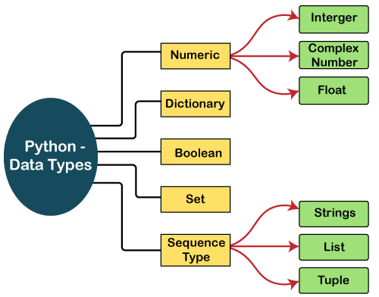
Python Data Types

Slide 10
Python Lists
A list in Python is used to store the sequence of various types of data.
The items in the list are separated with the comma (,) and enclosed with the square brackets [].
L1 = ["John", 102, "USA"]

Slide 11
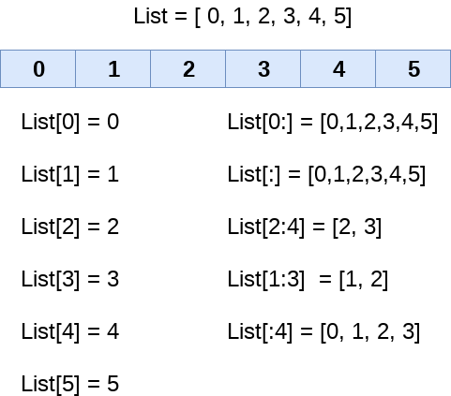
List indexing and splitting
The index starts from 0 and goes to length - 1. The first element of the list is stored at the 0th index, the second element of the list is stored at the 1st index, and so on.

Slide 12
Updating List values
Lists are the most versatile data structures in Python since they are ordered and mutable, and their values can be updated by using the slice and assignment operator.
Python also provides append() and insert() methods, which can be used to add values to the list.
The list elements can also be deleted by using the del keyword. Python also provides us the remove() method if we do not know which element is to be deleted from the list.

Slide 13
List Operations
Operator | Description | Example
Repetition | The repetition operator enables the list elements to be repeated multiple times. | l1*2 = [1, 2, 3, 4, 1, 2, 3, 4]
Concatenation | It concatenates the list mentioned on either side of the operator. | l1+l2 = [1, 2, 3, 4, 5, 6, 7, 8]
Membership | It returns true if a particular item exists in a particular list otherwise false. | print(2 in l1) prints True.
Iteration | The for loop is used to iterate over the list elements. | for i in l1: print(i)
Length | It is used to get the length of the list | len(l1) = 4

Slide 14
Python Tuples
Python Tuple is used to store the sequence of immutable Python objects
A tuple can be written as the collection of comma-separated (,) values enclosed with the small () brackets. The parentheses are optional, but it is good practice to use.
T= (101, "Banana", "Orange")

Slide 15
Python Set
A Python set is the collection of the unordered items. Each element in the set must be unique, and the sets remove the duplicate elements. Sets are mutable which means we can modify it after its creation.
there is no index attached to the elements of the set, i.e., we cannot directly access any element of the set by the index.
Days = {"Monday", "Tuesday", "Wednesday", "Thursday", "Friday", "Saturday", "Sunday"}

Slide 16
Python Set Cont.
Python also provides the set() method, which can be used to create the set by the passed sequence.
Python provides the add() method and update() method which can be used to add some particular item to the set. The add() method is used to add a single element whereas the update() method is used to add multiple elements to the set.
Python provides the discard() and remove() method which can be used to remove the items from the set, using discard() function if the item does not exist in the set, then the set remain unchanged whereas remove() method will through an error.
Python provides the clear() method to remove all the items from the set

Slide 17
Python Set Operations
Set can be performed mathematical operation such as union, intersection, difference, and symmetric difference. Python provides the facility to carry out these operations with operators or methods.
The union of two sets is calculated by using the pipe (|) operator. The union of the two sets contains all the items that are present in both the sets.
Python also provides the union() method which can also be used to calculate the union of two sets.
Days1.union(Days2)

Slide 18
Python Set Operations Cont.
The intersection of two sets can be performed by the and & operator or the intersection() function. The intersection of the two sets is given as the set of the elements that common in both sets.
The intersection_update() method removes the items from the original set that are not present in both the sets.
The difference of two sets can be calculated by using the subtraction (-) operator or intersection() method.

Slide 19

Python Dictionary
Python Dictionary is used to store the data in a key-value pair format.
It is the mutable data-structure
Keys must be a single element
Value can be any type such as list, tuple, integer, etc.
Employee = {"Name": "John", "Age": 29, "salary":25000,"Company":"GOOGLE"}

Slide 20

Python Arrays
from array import *
arrayName = array(typecode, [initializers])

Slide 21
Python Arithmetic Operators
Operator | Description
+ (Addition) | It is used to add two operands. For example, if a = 20, b = 10 => a+b = 30
- (Subtraction) | It is used to subtract the second operand from the first operand. If the first operand is less than the second operand, the value results negative. For example, if a = 20, b = 10 => a - b = 10
/ (divide) | It returns the quotient after dividing the first operand by the second operand. For example, if a = 20, b = 10 => a/b = 2.0
* (Multiplication) | It is used to multiply one operand with the other. For example, if a = 20, b = 10 => a * b = 200
% (reminder) | It returns the reminder after dividing the first operand by the second operand. For example, if a = 20, b = 10 => a%b = 0
** (Exponent) | It is an exponent operator represented as it calculates the first operand power to the second operand.
// (Floor division) | It gives the floor value of the quotient produced by dividing the two operands.

Slide 22
Python Comparison operator
Operator | Description
== | If the value of two operands is equal, then the condition becomes true.
!= | If the value of two operands is not equal, then the condition becomes true.
<= | If the first operand is less than or equal to the second operand, then the condition becomes true.
>= | If the first operand is greater than or equal to the second operand, then the condition becomes true.
> | If the first operand is greater than the second operand, then the condition becomes true.
< | If the first operand is less than the second operand, then the condition becomes true.

Slide 23
Python Logical Operators
and | If both the expression are true, then the condition will be true. If a and b are the two expressions, a → true, b → true => a and b → true.
or | If one of the expressions is true, then the condition will be true. If a and b are the two expressions, a → true, b → false => a or b → true.
not | If an expression a is true, then not (a) will be false and vice versa.

Slide 24
Python If-else statements
if expression 1:
# block of statements
elif expression 2:
# block of statements
elif expression 3:
# block of statements
else:
# block of statements

Slide 25
Python for loop
for iterating_var in sequence:
statement(s)
for i in range(1,11):
c = n*i

Slide 26

Python While loop
while expression:
statements

Slide 27

Python Function
def my_function(parameters):
function_block
return expression

Slide 28
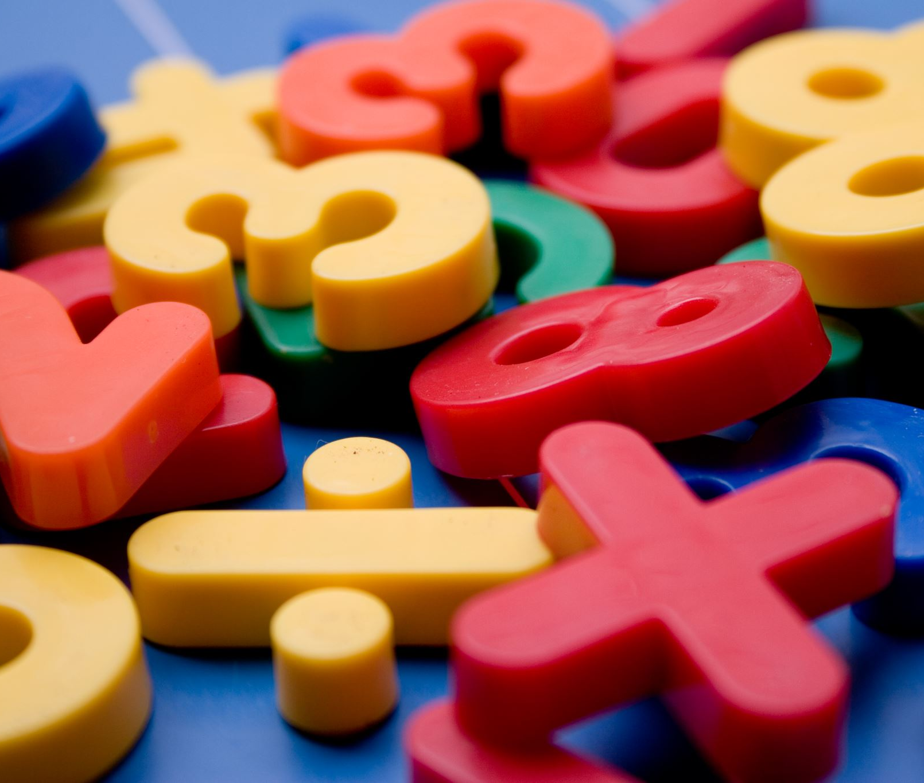
Python Math Module
math.log()
math.exp()
math.pow(x,y)
math.factorial()

Slide 29
Python Sheet
Write a Python program to find the area of a triangle.
Write a Python Program to Find the Factorial of a Number.
Write a Python Program to Check if a Number is Odd or Even.
Write a Python Program to Display the Multiplication Table.

Slide 30

Python Case Study
Write an Employee Management System in Python. The script will contain the following operations:
Add Employee
Remove Employee
Promote Employee
Display Employees

Slide 31
